Slide 1
PROJECT TITLE : MY CITY INFORMATION MOBILE APP FOR VISUALLY IMPAIRED PEOPLE
PIP104 University Project-II
Review-2
Batch Number: CSE-G21
Under the Supervision of,
Dr. Ramesh Sengodan
Professor
School of Computer Science & Engineering
Presidency University
Roll Number | Student Name
20201CSE0114 | MEGHANA S
20201CSE0115 | KORLA DHANUNJAYA
20201CSE0110 | SHASHIKALA P

Slide 2
Abstract
Obstacle detection and warning can improve the mobility as well as the safety of visually impaired people specially in unfamiliar environments.
For this, firstly, obstacles are detected and localized and then the information of the obstacles will be sent to the visually impaired people by using different modalities such as voice.
In this project, we present an assistive system for visually impaired people based on TensorFlow object detection model and Google Speech’s model.

Slide 3
Literature Survey
Sl No | Journal Type with Year | Authors | Title | Outcomes | Drawbacks
1 | IEEE Transaction (2017) | J.K. Sung, Y.H. Kim, and H.K. In | “Development of an intelligent guide-stick for the blind” | It consists of an ultrasound displacement sensor, two DC motors, and a micro-controller. | Existing paper works and solutions related to GPS-GSM.
2 | IEEE Transaction (2015) | S. Maeyama, A. Ohya, and S. Yuta | “Positioning by tree detection sensor and dead reckoning for outdoor navigation of a mobile robot” | It proposes positioning method for outdoor navigation of a mobile robot. | Existing paper works and solutions related to GPS-GSM.

Slide 4
Literature Survey
Sl No | Journal Type with Year | Authors | Title | Outcomes | Drawbacks
3 | IEEE ISIE (2010) | J. Rudan and Z. Tuza | Laser rangefinder for indoor metric map building | The design and implementation of a scan matching based map building method is described in this paper. | These technologies have been implemented individually but not integrated for the cause of blind
4 | IEEE Transaction (2008) | B. Ando | A smart multisensory approach to assist blind people in specific urban navigation tasks | This paper describes the designation of the smart assistance device | Existing paper works and solutions related to GPS-GSM.

Slide 5
Literature Survey
Sl No | Journal Type with Year | Authors | Title | Outcomes | Drawbacks
5 | IEEE Transaction (2001) | J.K. Sung, Y.H. Kim, and H.K. In | Development of an intelligent guide-stick for the blind | The intelligent guide stick followed the path of the road successfully avoiding the obstacle. | It does not consists of an ultrasound displacement sensor
Common Drawback : Existing paper works and solutions related to GPS-GSM. These technologies have been implemented individually but not integrated for the cause of blind

Slide 6
Objectives
Develop a mobile app that provides comprehensive information about a city.
Make the app easy to use and navigate.
Develop a user-friendly mobile application for Android platforms.
Provide users with information about local attractions, restaurants, public transportation, events, and emergency services.
Promote the city's tourism industry and increase engagement with local businesses.

Slide 7
Existing Methods and Drawbacks
Blind people have to take help of someone in their day-to-day life. Without the help of someone they cannot complete daily activities in their life.
Because while walking to somewhere or crossing roads, they have to come across many obstacles like a wall, vehicles, trees, tables and chairs.
These obstacles are harmful to visually impaired people.
Hence they are taking help of other people in most of the scenarios.
Disadvantages :
Makes dependent.
Harmful.
Time Consuming

Slide 8
Proposed Method
Navigation and Obstacle detection for visually impaired.
We have developed an android application :
To detect obstacles on their way of blind peoples walk and
Telling them on which direction what objects are placed so that should help them in knowing things that they come across and to turn themselves on a right way.
Advantages :
Makes Independent
It is safe and ecofriendly application.
Saves time and helps them to achieve daily tasks.

Slide 9
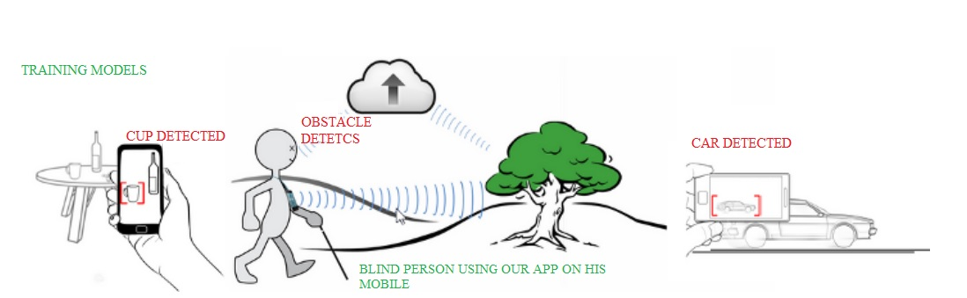







Architecture Diagram

Slide 10
Modules
User : User will use these application for Obstacle detection with audio feedback. It will navigate with audio feedback based on input it will redirect to Google Maps.
Obstacle Detection : It detects the obstacles and objects if encountered in contact of the blind person with the help of ultrasonic sensor(it measures the distance to an object using ultrasonic sound waves).
GPS Navigation : Navigation is understood as the process of reaching from one position to another. This was the original objective for developing GPS.

Slide 11
Hardware and Software Details
Hardware System Configurations :
Processor - 13/Intel Processor
RAM - 8 GB
Hard Disk - 1TB
Software System Configurations :
Operating System - Windows 1
JDK - java
SDK - Android
IDE - Android studio
Database - SQL

Slide 12
Implementation Details
Android Studio IDE and SDK Installation : Installing Android software is probably the most challenging part of this project. It takes times from 30 minutes to n hours to forever - depending on your luck, your programming knowledge, and your PC. You probably need a fairly decent PC (with 8GB RAM) and 10GB of free disk space to run the Android emulator!!! Running on "actual" Android phone/tablet requires much lesser resources.
Steps :
Pre-Installation Check List
Install "Android Studio IDE"
Installing Android SDK

Slide 13
Implementation Details
Step 1: Pre-Installation Check List
Before installing Android SDK, you need to install Java Development Kit (JDK). Read "How to install JDK". Ensure that your JDK is at or above 1.8. You can check your JDK version with command "javac -version".
Uninstall older version(s) of "Android Studio" and "Android SDK“ if any.
The installation and many operations take a LONG time to complete. Do NOT stare at your screen or at the ceiling. Browse through the "Android Developers" @ https://developer.android.com. For developers, check out the "Developer Guides".
We need to install two huge packages:
Android Studio (IDE) (about 1 GB), which is an Integrated Development Environment (IDE) based on IntelliJ (a popular Java IDE); and
Android SDK (Software Development Kit) (about 5 GB) for developing and testing Android apps

Slide 14
Implementation Details
Step 2: Install "Android Studio IDE“
Reference: "Install Android Studio"@ https://developer.android.com/studio/install.
(For Windows) :
Check that environment variable JAVA_HOME is set to the JDK installation directory via command "set JAVA_HOME". Otherwise, Follow the steps HERE.
Check the system requirements for Android Studio/SDK @ https://developer.android.com/studio#Requirements e.g., For Windows 10, recommended 8GB of RAM, 4GB of disk space, and 1280x800 minimum screen resolution.
Go to "Android Studio" @ https://developer.android.com/studio ⇒ Click "Download Android Studio 3.6.x for Windows 64-bit (749MB)", e.g., "android-studio-ide-192.xxxxxxx-windows.exe".
Run the downloaded installer ⇒ You may watch a short video @ https://developer.android.com/studio/install.
In "Choose Components", select "Android Studio" and "Android Virtual Device".
In "Configuration Settings Install Location", accept the default "C:\Program Files\Android\Android Studio".
In "Choose Start Menu Folder", accept the default ⇒ Install.
Launch Android Studio. Continue to the next Step.
by default, the "Android Studio IDE" will be installed in "C:\Program Files\Android\Android Studio", and the "Android SDK" in "c:\Users\username\AppData\Local\Android\Sdk".

Slide 15
Implementation Details
Step 3: Installing Android SDK
This step takes a long time as you need to download about 3GB of zip data, and expand to 5 GB of disk data, even for the minimum configuration.
Note: You can actually copy the SDK from another computer with the same OS.
(For Windows and macOS) :
Launch Android Studio ⇒ It will run the "setup" wizard for the first launch.
Choose "do not import previous settings".
In "Welcome", choose "next".
In "Install Type", choose "Standard" (default).
In "Select UI Theme", choose one that you like (or default).
In "SDK Components Setup", make sure that "Android Virtual Device" is selected and take note of the SDK directory (by default @ c:\Users\username\AppData\Local\Android\Sdk for Windows, "~/Library/Android/sdk" for macOS) ⇒ Finish ⇒ Wait ⇒ Wait ⇒ Wait ⇒ Wait ⇒ Wait ⇒ Wait.

Slide 16
Implementation Details
(For Windows) : Use "File Explorer" to check the SDK installed directory. Take note that the "App Data" is a hidden directory. You need to choose "View" menu ⇒ Uncheck "Hidden Items" to see this directory.
(For macOS) : Use "Finder" to check the SDK installed directory.
Also use "Android Studio" to check the SDK packages installed by selecting "Configure" (at the bottom of Android Studio) ⇒ "SDK Manager" ⇒ "Android SDK" (sidebar):
Under "SDK Platforms" tab:
Android 10.0 (Q) (API Level 29)
Under "SDK Tools" tab:
Android SDK Build Tools 30-rc1
Android Emulator (30.0.0)
Android SDK Platform-Tools (29.0.6)
Intel x86 Emulator Accelerator (HAXM installer) (7.5.6)

Slide 17
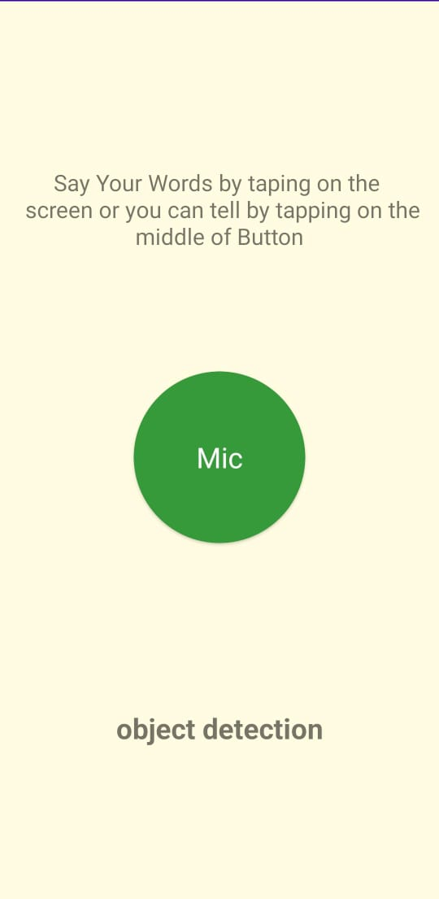
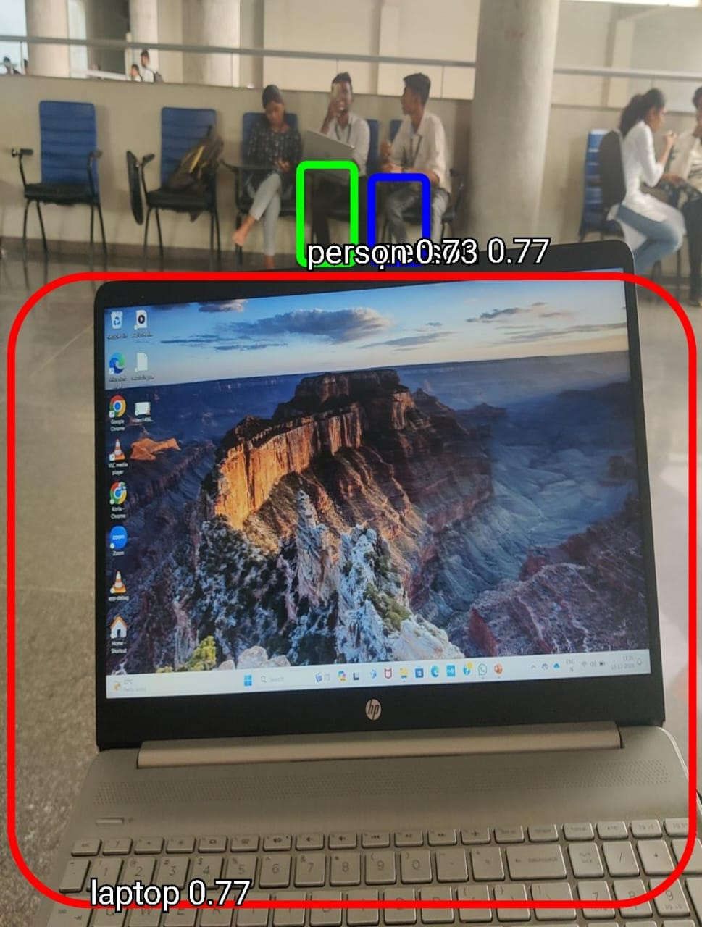
Screenshots

Slide 18
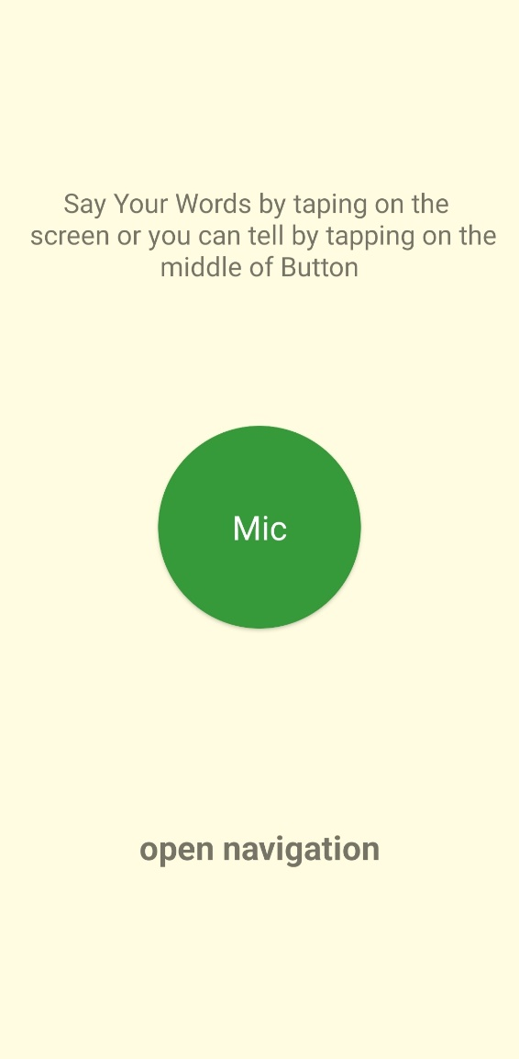
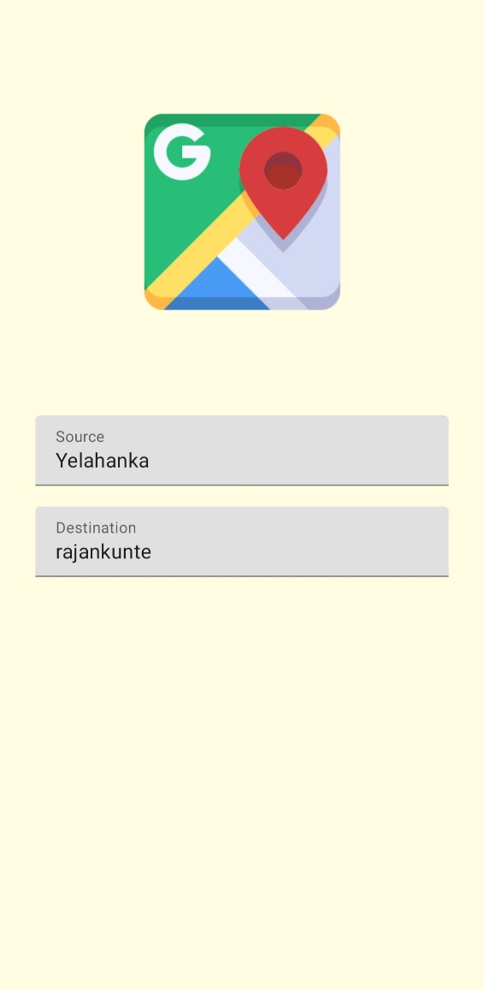
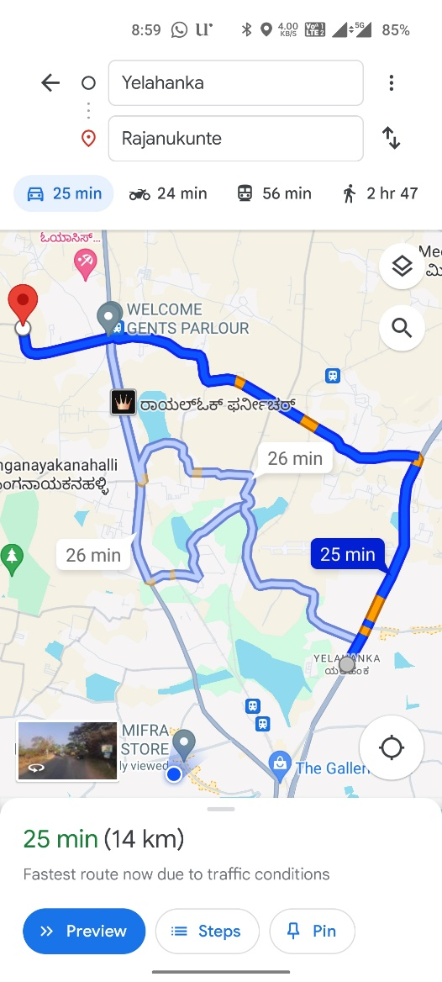
Screenshots

Slide 19
Timeline of Project
The project is estimated to be completed in six months, with the following milestones:
Month 1-2: Project Planning and Design
Month 3-4: Development and Testing
Month 5: Deployment
Month 6: Maintenance and Support

Slide 20
References
A navigational aid for persons with severe visual impairments: A project in progress," in Proc. Int. Conf. IEEE Eng. Med Biol. Soc., Cancun, Mexico, Sep. 17-21, 2003.
S. Maeyama, A. Ohya, and S. Yuta, "Positioning by tree detection sensor and dead reckoning for outdoor navigation of a mobile robot, " in IEEE Int. Conf. Multisensor Fusion and Integration for Intelligent Systems '94, pp. 653-660, 1994.
B. Andò, "A smart multisensory approach to assist blind people in specific urban navigation tasks, " IEEE Transactions Neural Systems and Rehabilitation Engineering, vol. 16, no. 6, pp. 592-594, Dec. 2008.
J.K. Sung, Y.H. Kim, and H.K. In, "Development of an intelligent guide-stick for the blind, " in IEEE Proc. Int. Conf. Robotics and Automation, vol. 4, pp. 3208-3213, 2001.
J. Rudan and Z. Tuza. Using LMS-100 laser rangefinder for indoor metric map building. In Proceedings of 2010 IEEE International Symposium on Industrial Electronics (ISIE2010). IEEE ISIE, 2010.

Slide 21
References
M. Alwan, M.B. Wagner, G. Wasson, and P. Sheth. Characterization of infrared range-finder pbs-03jn for 2-d mapping. In Robotics and Automation, 2005. ICRA 2005. Proceedings of the 2005 IEEE International Conference on, pages 3936-3941, April 2005
Yoichi Okubo; Cang Ye; Johann Borenstein. Characterization of the hokuyo urg-04lx laser rangefinder for mobile robot obstacle negotiation. In Unmanned Systems Technology XI. Proceedings of the SPIE, 2009.
Sierra, Javier S; Togores, Joaquin SR. Designing mobile apps for visually impaired and blind users. The Fifth International Conference on Advances in Computer-Human Interactions, 2012, 47-52.
Oliveira, Joao; Guerreiro, Tiago; Nicolau, Hugo; Jorge, Joaquim; Goncalves, Daniel. “BrailleType: unleashing braille over touch screen mobile phones”. Proceedings of the 13th IFIP TC 13 international conference on Human-computer interaction., 2011.
Bigham, JP; Cavender, AC; Brudvik, JT; Wobbrock, JO; Ladner, RE. “WebinSitu: A Comparative Analysis of Blind and Sighted Browsing Behavior”, ASSETS’07, Tempe, Arizona, USA, Ocy, 15-17, 2007

Slide 22
Thank You

